Slide 1
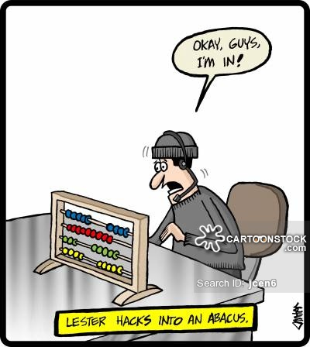
iFrames & Security
Graham Squires -- Intern Extraordinaire

Slide 2
Example
https://online.citi.com/US/login.do
can frame
https://www.citibank.com.sg/portal/bluehome/index.htm

Slide 3
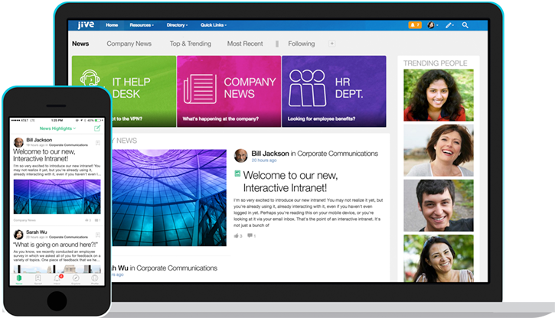
Collaboration Between Sites -- 2 Security Solutions
1. Window.postMessage() method--https://developer.mozilla.org/en-US/docs/Web/API/Window/postMessage
2. X-Frame : Deny

Slide 4
window.postMessage()
targetWindow.postMessage(message, targetOrigin, [transfer]);
The window.postMessage() method safely enables cross-origin communication between Window objects; e.g., between a page and a pop-up that it spawned, or between a page and an iframe embedded within it.
Normally, scripts on different pages are allowed to access each other if and only if the pages they originate from share the same protocol, port number, and host (also known as the "same-origin policy"). window.postMessage() provides a controlled mechanism to securely circumvent this restriction (if used properly).
Broadly, one window may obtain a reference to another (e.g., via targetWindow = window.opener), and then dispatch a MessageEvent on it with targetWindow.postMessage(). The receiving window is then free to handle this event as needed. The arguments passed to window.postMessage() (i.e., the “message”) are exposed to the receiving window through the event object.

Slide 5
targetWindow
A reference to the window that will receive the message. Methods for obtaining such a reference include:
Window.open (to spawn a new window and then reference it),
Window.opener (to reference the window that spawned this one),
HTMLIFrameElement.contentWindow (to reference an embedded <iframe> from its parent window),
Window.parent (to reference the parent window from within an embedded <iframe>), or
Window.frames + an index value (named or numeric).

Slide 6
Message
Data to be sent to the other window. The data is serialized using the structured clone algorithm. This means you can pass a broad variety of data objects safely to the destination window without having to serialize them yourself. [1]

Slide 7
targetOrigin
Specifies what the origin of targetWindow must be for the event to be dispatched, either as the literal string "*" (indicating no preference) or as a URI. If at the time the event is scheduled to be dispatched the scheme, hostname, or port of targetWindow's document does not match that provided in targetOrigin, the event will not be dispatched; only if all three match will the event be dispatched. This mechanism provides control over where messages are sent; for example, if postMessage() was used to transmit a password, it would be absolutely critical that this argument be a URI whose origin is the same as the intended receiver of the message containing the password, to prevent interception of the password by a malicious third party. Always provide a specific targetOrigin, not *, if you know where the other window's document should be located. Failing to provide a specific target discloses the data you send to any interested malicious site.

Slide 8
transfer (Optional)
Is a sequence of Transferable objects that are transferred with the message. The ownership of these objects is given to the destination side and they are no longer usable on the sending side.

Slide 9
The Dispatched Event
otherWindow can listen for dispatched messages by executing the following JavaScript:
window.addEventListener("message", receiveMessage, false); function receiveMessage(event) { if (event.origin !== "http://example.org:8080") return; }

Slide 10
Properties of Dispatched Message
data
The object passed from the other window.
origin
The origin of the window that sent the message at the time postMessage was called. This string is the concatenation of the protocol and "://", the host name if one exists, and ":" followed by a port number if a port is present and differs from the default port for the given protocol. Examples of typical origins are https://example.org (implying port 443), http://example.net (implying port 80), and http://example.com:8080. Note that this origin is not guaranteed to be the current or future origin of that window, which might have been navigated to a different location since postMessage was called.
source
A reference to the window object that sent the message; you can use this to establish two-way communication between two windows with different origins.

Slide 11
Security & window.postMessage()
If you do not expect to receive messages from other sites, do not add any event listeners for message events. This is a completely foolproof way to avoid security problems.
If you do expect to receive messages from other sites, always verify the sender's identity using the origin and possibly source properties. Any window (including, for example, http://evil.example.com) can send a message to any other window, and you have no guarantees that an unknown sender will not send malicious messages. Having verified identity, however, you still should always verify the syntax of the received message. Otherwise, a security hole in the site you trusted to send only trusted messages could then open a cross-site scripting hole in your site.
Always specify an exact target origin, not *, when you use postMessage to send data to other windows. A malicious site can change the location of the window without your knowledge, and therefore it can intercept the data sent using postMessage.

Slide 12
window.postMessage() Demo: 2 HTML login sites securely collaborating
http://0.0.0.0:8080
http:// 127.0.:9090

Slide 13
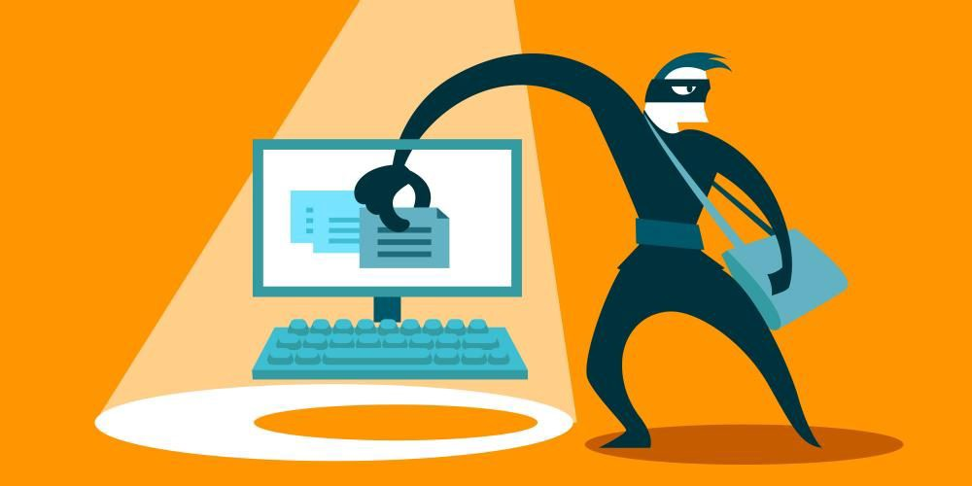
Security and Framing--
Source: https://stackoverflow.com/questions/7289139/why-are-iframes-considered-dangerous-and-a-security-risk
The only real protection from this attack is to add HTTP header X-Frame-Options: DENY and hope that the browser knows its job.
The IFRAME element may be a security risk if your site is embedded inside an IFRAME on hostile site. Note that it does not matter if you use <iframe> or not. The only real protection from this attack is to add HTTP header X-Frame-Options: DENY and hope that the browser knows its job.

Slide 14
Security & Framing (2)
In addition, IFRAME element may be a security risk if any page on your site contains an XSS vulnerability which can be exploited.
In that case the attacker can expand the XSS attack to any page within the same domain that can be persuaded to load within an <iframe> on the page with XSS vulnerability.
This is because content from the same origin (same domain) is allowed to access the parent content DOM (practically execute JavaScript in the "host" document).
The only real protection methods from this attack is to add HTTP header X-Frame-Options: DENY and/or always correctly encode all user submitted data (that is, never have an XSS vulnerability on your site - easier said than done).

Slide 15
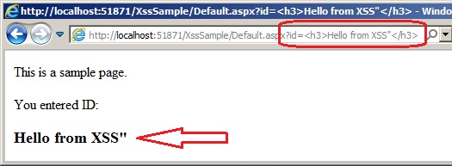
Security and Framing (3)
That's the technical side of the issue. In addition, there's the issue of user interface.
If you teach your users to trust that URL bar is supposed to not change when they click links (e.g. your site uses a big iframe with all the actual content), then the users will not notice anything in the future either in case of actual security vulnerability.
For example, you could have an XSS vulnerability within your site that allows the attacker to load content from hostile source within your iframe. Nobody could tell the difference because the URL bar still looks identical to previous behavior (never changes) and the content "looks" valid even though it's from hostile domain requesting user credentials.

Slide 16
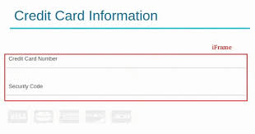
Security & Framing (4)
If somebody claims that using an <iframe> element on your site is dangerous and causes a security risk, he does not understand what <iframe> element does, or he is speaking about possibility of <iframe> related vulnerabilities in browsers. Security of <iframe src="..."> tag is equal to <img src="..." or <a href="..."> as long there are no vulnerabilities in the browser. And if there's a suitable vulnerability, it might be possible to trigger it even without using <iframe>, <img> or <a> element, so it's not worth considering for this issue.

Slide 17
Login Site Framed by HTML Page
https://real-app33.herokuapp.com/ is framed by 127.0.0.1:9090
- This is a PHP login site being framed by localhost.
- If this site were vulnerable to XSS an attacker could insert iframe and capture user information including form input and session information
- The dangers here are XSS and clickjacking

Slide 18
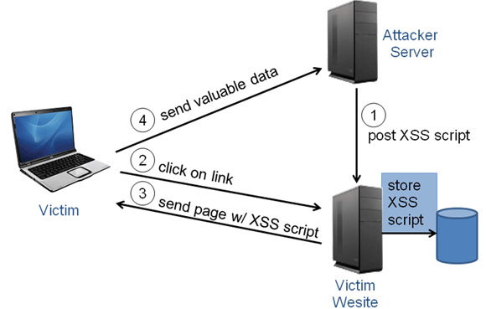
Summary
Clickjacking is a problem if your site is included as an iframe
A compromised iFrame could display malicious content (imagine the iFrame displaying a login box instead of an ad)
An included iframe can make certain JS calls like alert and prompt which could annoy your user
An included iframe can redirect via location.href (yikes, imagine a 3p frame redirecting the customer from citibank.com to citibank.fake.com)
Malware inside the 3p frame (java/flash/activeX) could infect your user

